Slide 1
Zackary West
Project: Bill Tracker
This project will create a space where a person can see all the bills they have due. It will keep each account, how much they owe, when the payment is due, and how much the payment is. This will eliminate having to go through so many apps.

Slide 2
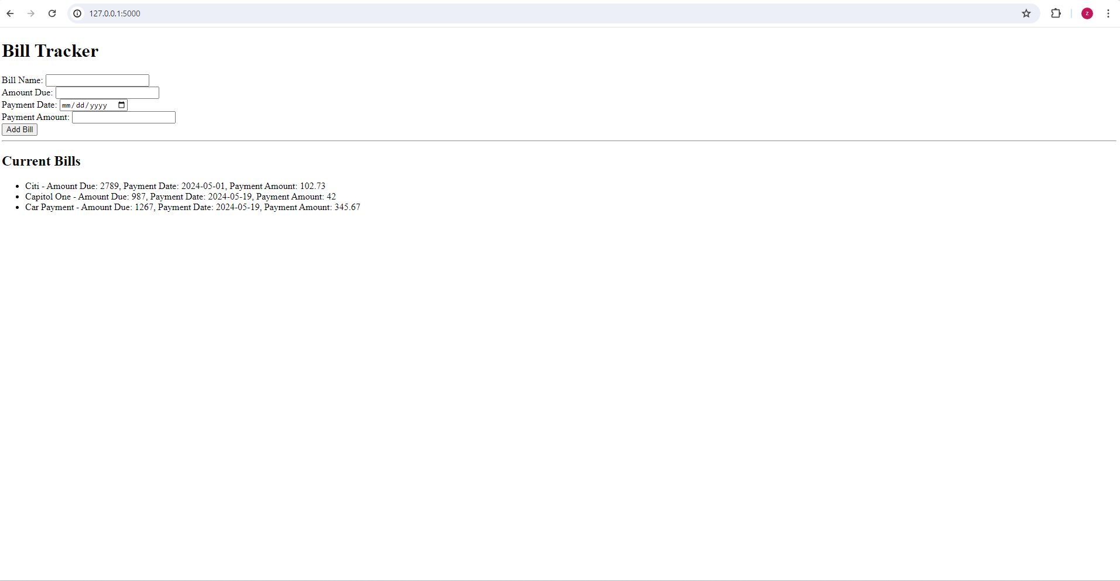

Slide 3
